Slide 1
Resilient road asset management under the EU Global Gateway
AFERA-SSATP Workshop Nairobi
18th September 2025

Slide 2
Roads as parts of multimodal Corridors
Global Gateway: concentrating investments in a limited number of corridors. Why?
Higher development impact
Driven by shared interests (partners’ and EU’s);
Green Deal: supporting more clean and efficient Corridors through the promotion of multi-modality and climate ambitions:
Corridor as a multimodal buffer: alternative routes linking cities/nodes;
Increased demand for transport in Africa paired with reduced environmental impacts and climate-resilient infrastructure;
Relevance of resilient road asset management to ensure sustainability of the investments and reliability of supply chains along the corridors

Slide 3
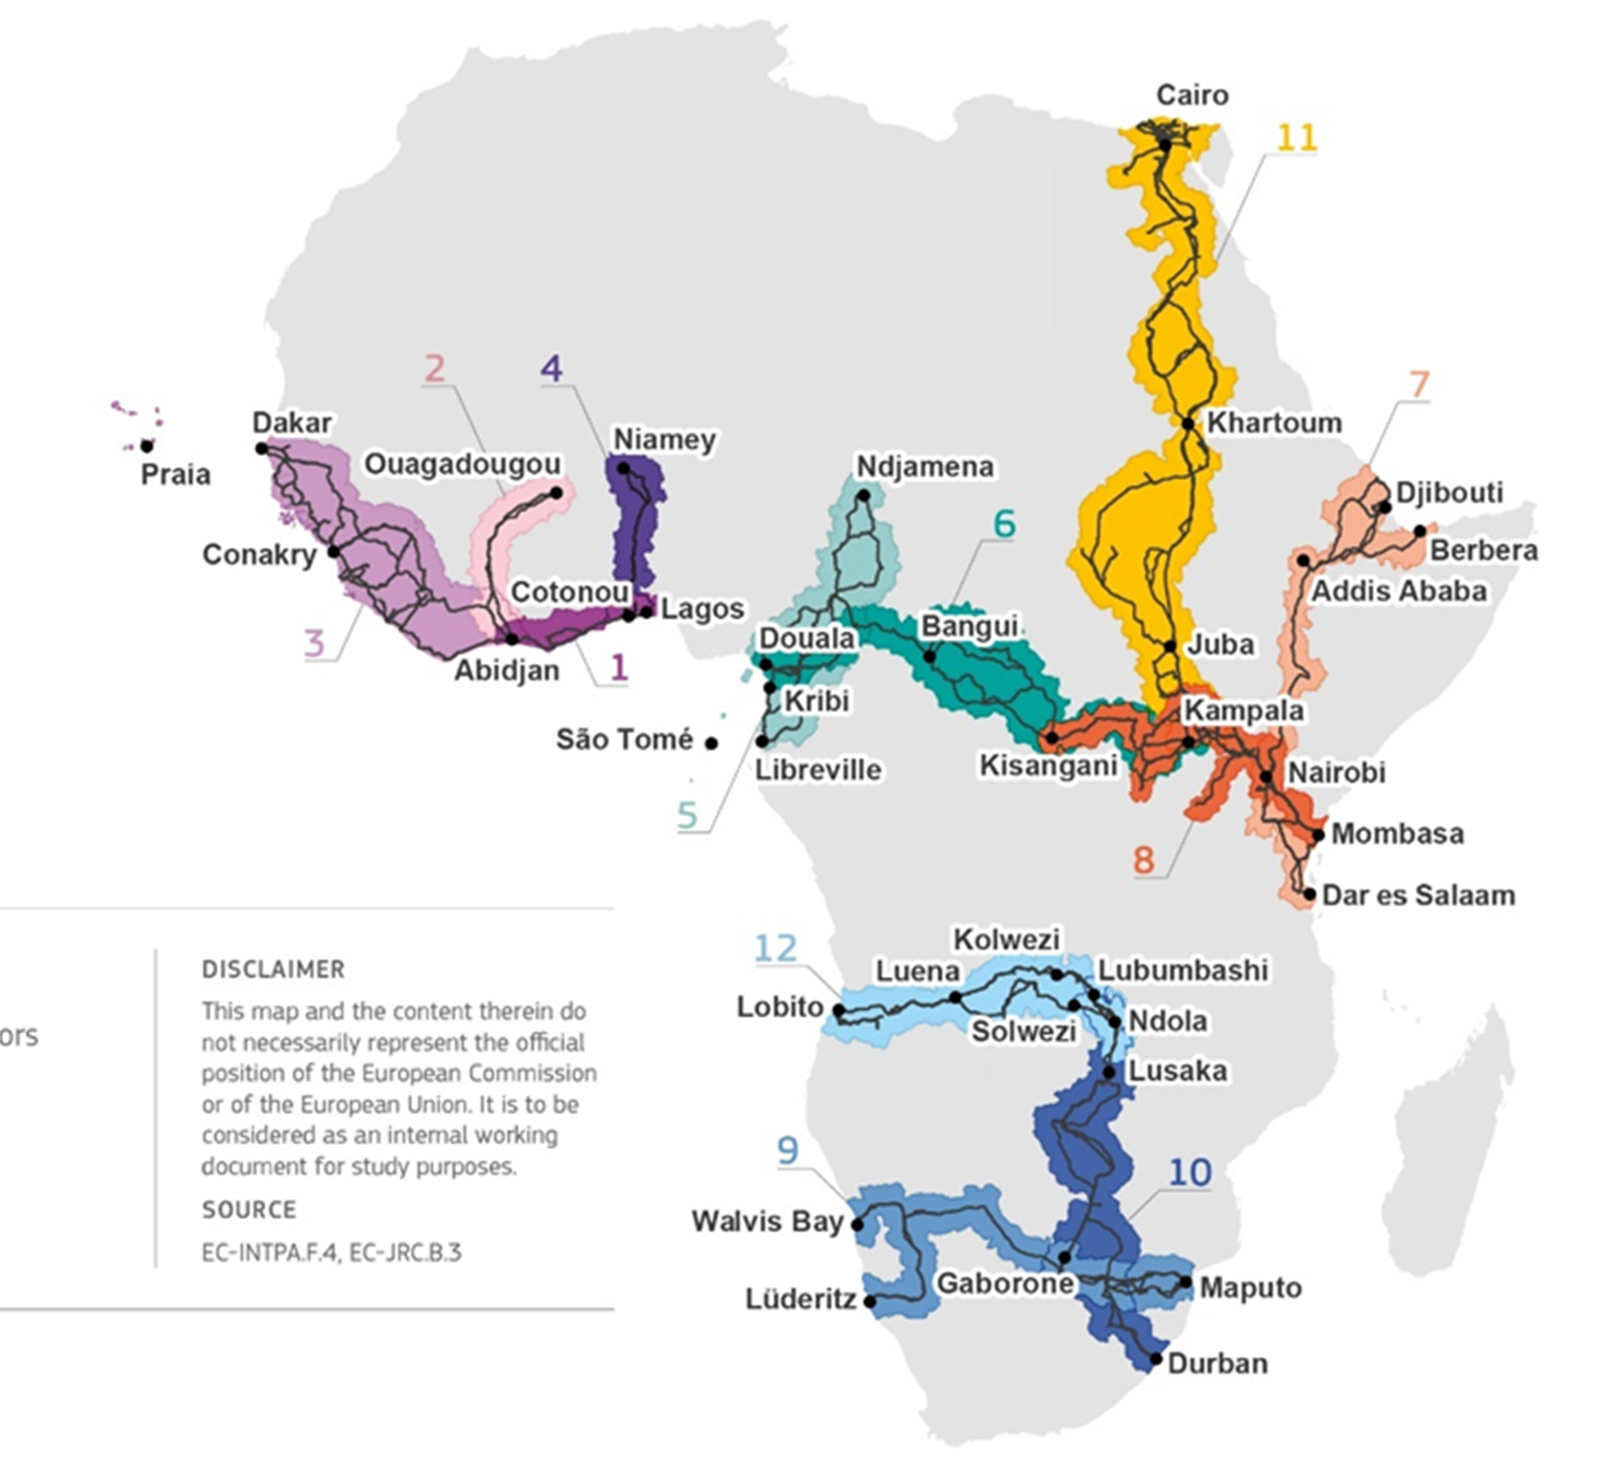
12 Global Gateway supported corridors
1. Abidjan-Lagos West Africa: Côte d’Ivoire, Ghana, Togo, Benin, Nigeria
2. Abidjan-Ouagadougou West Africa: Côte d’Ivoire, Burkina Faso
3. Dakar-Abidjan West Africa: Senegal, Gambia, Guinea-Bissau, Guinea, Sierra Leone, Liberia, Côte d’Ivoire, Cabo Verde
4. Cotonou-Niamey West Africa: Benin, Niger
5. Libreville-Kribi-Douala-N’Djamena Central Africa: Gabon, Equatorial Guinea, Cameroon, Chad, São Tomé and Príncipe
6. Douala-Kribi-Kampala Central Africa: Cameroon, Central African Republic, Democratic Republic of the Congo, Uganda
7. Dar es Salaam-Nairobi-Addis Ababa-Berbera-Djibouti East Africa: Tanzania, Kenya, Ethiopia, Somalia, Djibouti
8. Mombasa-Kisangani East Africa: Kenya, Uganda, Rwanda, Democratic Republic of the Congo
9. Maputo-Gaborone-Walvis Bay Southern Africa: Mozambique, South Africa, Eswatini, Botswana, Namibia
10. Durban-Lusaka-Lubumbashi Southern Africa: South Africa, Botswana, Zimbabwe, Zambia
11. Cairo-Khartoum-Juba-Kampala North and East Africa: Egypt, Soudan, South Sudan, Uganda
12. Lobito-Kolwezi-Lubumbashi/Solwezi-Ndola Southern and Central Africa: Angola, Democratic Republic of the Congo, Zambia

Slide 4
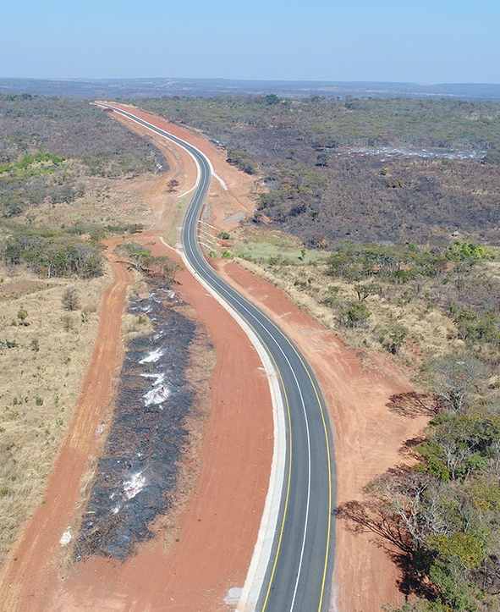
EU investments in hard infrastructure
Roads: EU traditional field of intervention
Currently mainly through blending with DFIs
EU less involved in project design and monitoring
Less policy dialogue with partner countries – new tools such as PBF allow for closer sectoral dialogue
~1,5 bill€ in grants (for all transport sectors)
Pipeline of road projects
Chad – Ndjamena-Moundou-Koutéré (OPBRD WB/EIB)
Cameron - RN3 Cameroon; Yaounde bypass; Ntem bridge
Cameroon -DRC - Zongo-Akula
Guinea Bissau – Safim-Mpack (border SN)
Djibouti: RN1 Doudoubalala – Iskoutir
Mali- Banfora – Border IC
Notes:
PBF=performance-based financing

Slide 5
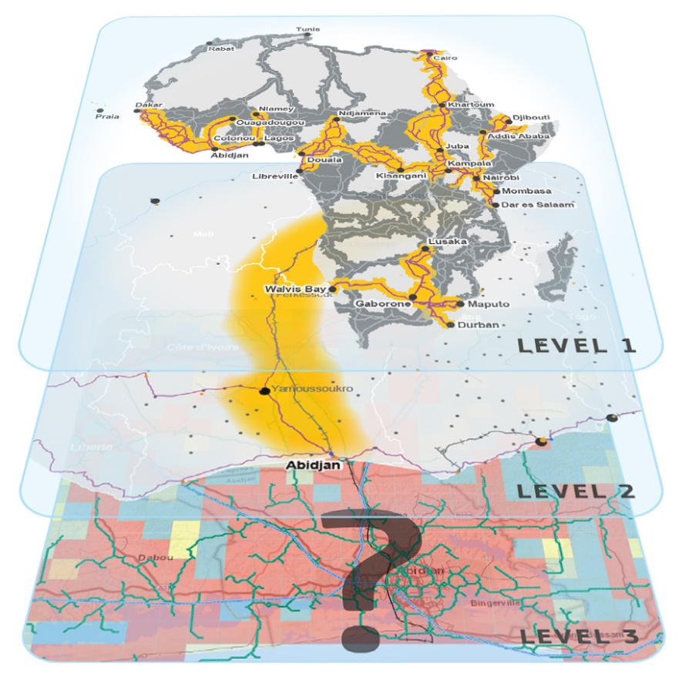
EU support to road governance (incl. maintenance)
At policy level: main donor of SSATP (total ~11M€)
At regional level (RECs): harmonize transport and transit policies and regulations (total ~32M€)
COMESA/EAC/SADC: Tripartite Transport & Transit Facilitation Programme
ECOWAS and Central Africa: under preparation
At corridor level: ~25M€/ corridor for trade and transport facilitation measures (total ~300M€)
At country level: innovative approaches being prepared/tested, such as OPRBC (Chad/Djibouti), PBF Cameroon Road Fund, PBL Senegal with EIB
Notes:
PBL=performance-based loan
OPBRC=output and performance-based road contracts

Slide 6
Main challenges and opportunities
Institutional fragmentation: lack of clear arrangements/mandates between national, corridor and regional bodies
Opportunity for donors to align at different levels and avoid overlapss
Non-physical barriers and cross-border coordination: lack of consistent standards, procedures and enforcement mechanism across neighboring countries, especially in corridors crossing different RECs
Opportunity to support cross-border initiatives (e.g. harmonized axle load control, interoperability and domestication of international conventions, etc.)
Under-funding of road maintenance: role of the Road Funds
Opportunity to incorporate alternative sources of financing, such as PBF by donors and private sector
Climate change: need to consider incorporate resilience aspects
Opportunity to incorporate resilience since the planning phases

Slide 7
Thank you!

